Slide 1

Pitch Deck
CHAMPIONING SOCIAL JUSTICE: EDUCATING ON HUMAN RIGHTS
CHERYL RACHAEL MAKOKHA
08 September, 2024
CANVA LINK
SOCIAL
JUSTICE

Slide 2
Leveraging Technology for Social Reform
SOCIAL
JUSTICE

Slide 3
TABLE OF CONTENTS
Problem Statement
Solution Overview
Goals and Objectives
Hackathon Theme and Subthemes
Website Features
Target Audience
Development Plan
Expected Impact and Benefits
Call to Action
SOCIAL
JUSTICE

Slide 4
THE CHALLENGE
Many African nations face socio-political challenges.
Recent youth-led protests highlight discontent with leadership, economic inequality, and lack of accountability.
There is a need for innovative solutions to address these urgent issues.
SOCIAL
JUSTICE

Slide 5
OUR SOLUTION
Develop a website to educate people on their human rights.
Use the UN Declaration of Human Rights as the foundational content.
Aim to empower citizens with knowledge to drive social justice and reform.
SOCIAL
JUSTICE

Slide 6
GOALS AND OBJECTIVES
Inspire and empower participants to create tech-driven solutions.
Foster innovation and problem-solving among young Africans.
Empower youth to actively shape their future.
Create a platform for collaboration among participants, mentors, and experts.
SOCIAL
JUSTICE

Slide 7
HACKATHON THEME AND SUBTHEMES
Theme: Championing Social Justice and Driving Reform.
Subthemes:
Human Rights and Security: Protecting citizens' rights, ensuring safety, addressing social injustices.
SOCIAL
JUSTICE

Slide 8
KEY FEATURES OF THE WEBSITE
User-friendly interface with HTML, CSS, and JavaScript.
Comprehensive sections on each article of the UN Declaration.
Interactive quizzes and resources for deeper understanding.
News and updates on human rights issues.
SOCIAL
JUSTICE

Slide 9
TARGET AUDIENCE
Young Africans aged 15-30.
Activists and community leaders.
Educators and students.
General public interested in human rights.
SOCIAL
JUSTICE

Slide 10
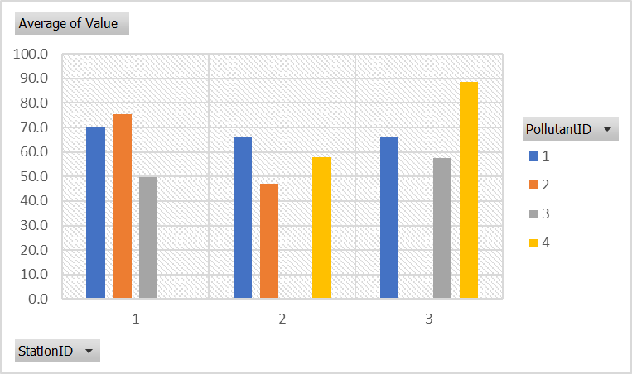
DEVELOPMENT PLAN
Phase 1:
Research and content creation.
Phase 2:
Website design and development (HTML, CSS, JavaScript).
Phase 3:
Testing and feedback collection.
Phase 4:
Launch and promotion.
SOCIAL
JUSTICE

Slide 11
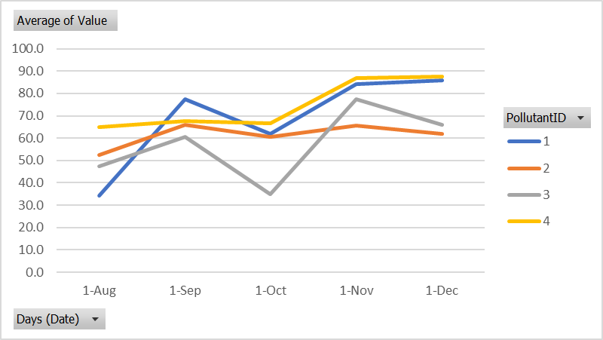
IMPACT AND BENEFITS
Increased awareness of human rights.
Empowerment of citizens to demand accountability and reform.
Creation of a knowledgeable and engaged community.
Contribution to social justice and sustainable development.
SOCIAL
JUSTICE

Slide 12
JOIN US IN MAKING A DIFFERENCE
Spread the word and raise awareness about human rights.
Collaborate with us to drive social justice and reform.
SOCIAL
JUSTICE

Slide 13
CONCLUSION
The project successfully educates and empowers citizens on human rights.
Aligns with key SDGs, contributing to social justice and sustainability. Call to Action:
Support and collaborate on expanding the educational platform.
Leverage insights for policy-making and community engagement.
SOCIAL
JUSTICE

Slide 14
Leveraging Technology for Social Reform
SOCIAL
JUSTICE

Slide 15
Thank you!
CHAMPIONING SOCIAL JUSTICE: EDUCATING ON HUMAN RIGHTS
CHERYL RACHAEL MAKOKHA
30 September, 2024
SOCIAL
JUSTICE

